Slide 1

Custom Driver For ESP32 To Blink Inbuilt LED
CH.CHANDANA
COURSE NAME:EMBEDDED SYSTEMS
SUPERVISOR:ANTONY RAJEEV

Slide 2
Overview
Introduction
Simple Led blink program in tinkercad using port manipulations.
Hardware required and Software required
Flowchart-Blink led without header files in ESP-IDF
Suretrust_led.h
Suretrust_led.h VS driver/gpio.h
Code Implementation
Flow of code
Result
Applications
Future Scope
Conclusion

Slide 3
Introduction
,
The primary objective of this project is to develop a custom driver ,named “Suretrust_led.h” that simplifies LED operations.
This driver is specially crafted to handle three core functionalities: blinking LED, controlling its intensity, and checks the pins for flexible hardware configurations.
Provides a versatile and efficient interface for LED management ,which can be easily integrated into various embedded systems projects.

Slide 4
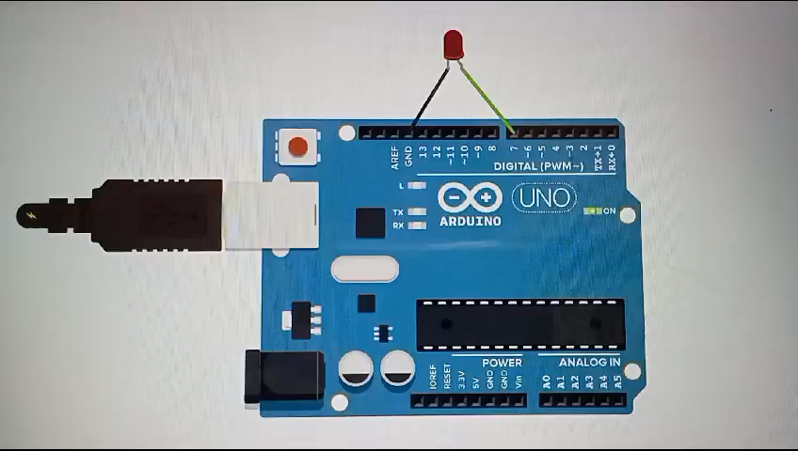
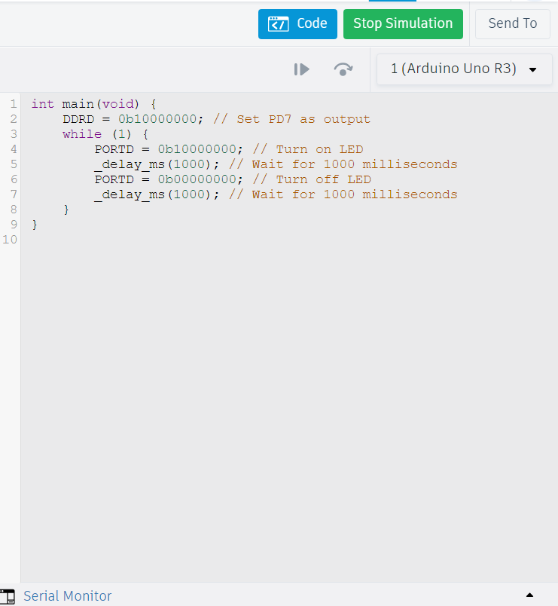
Simple LED blink program in tinkercad using port manipulations

Slide 5
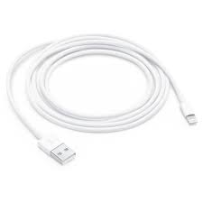
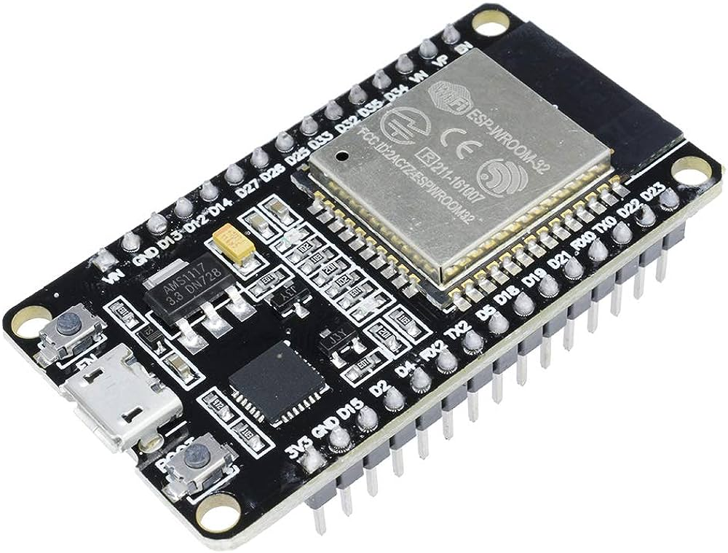
Hardware required
ESP32 Microcontroller
USB cable
Software required
Visual studio code
ESP-IDF extension

Slide 6
Flowchart-Blink Inbuilt led without Header files In ESP-IDF
Start
Suretrust_led_init()
While(1)
Suretrust_led_blink()
Turn LED on
delay_ms()
Turn LED off
delay_ms()
Loop return to while(1)
End

Slide 7
Suretrust_led.h
A custom library designed for the ESP32 microcontroller.
Simplifies the process of controlling of LEDs.
Key Features:
Blinking the inbuilt LED.
controlling LED brightness.
Identifying characteristics of pins on ESP32.

Slide 8
Suretrust_led.h VS driver/gpio.h
driver/gpio.h
Suretrust_led.h
Complexity
Potential for hardware damage
Performance Overhead
Debugging difficulty
Reduces Complexity and errors
Control of LED intensity
Easy Debugging
Easy to understand pin configurations

Slide 9
Code Implementation
Suretrust_led.c
Suretrust_led.h
main.c
main

Slide 10
Flow of code
Start
Suretrust_Led_Init()
Suretrust_Led_Set_Intensity()
Suretrust_Led_Blink ()
While(1)
Suretrust_Check_Pin()
End

Slide 11
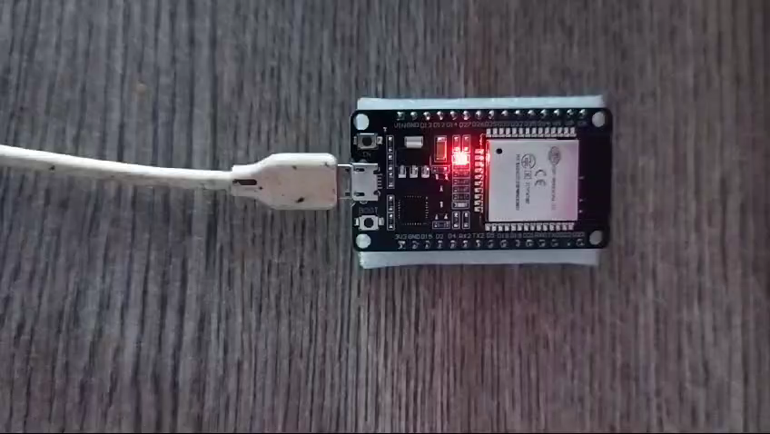
RESULT

Slide 12
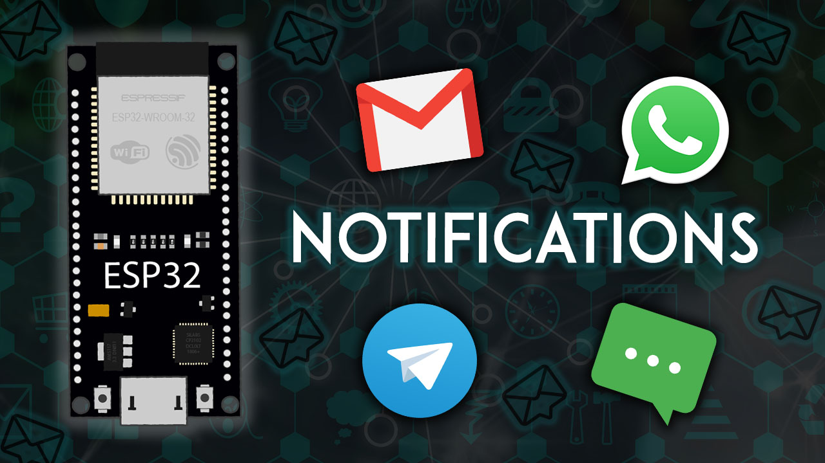
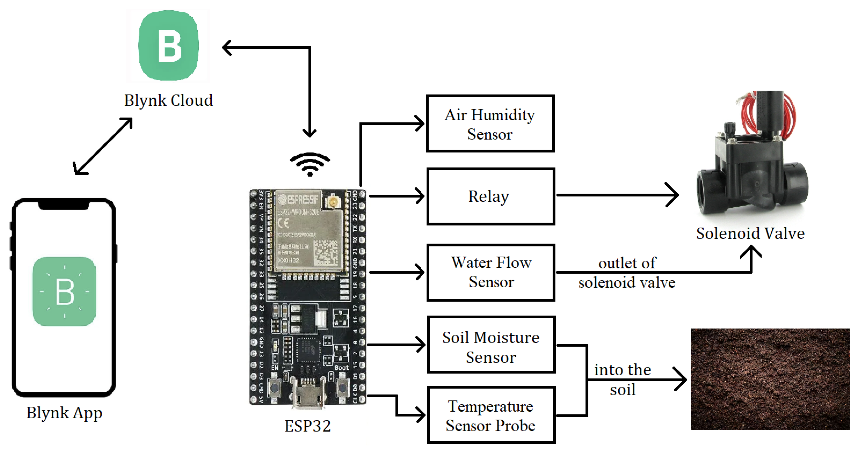
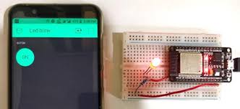
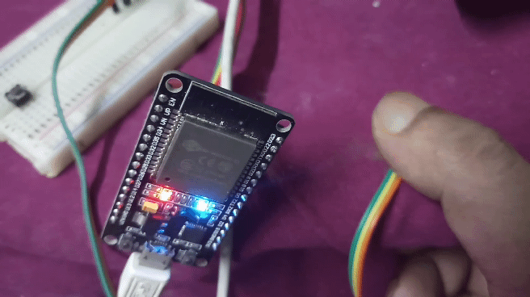
Applications
Smart Home Lighting Control
Notification and Alert Systems
Wearable technology
Medical Monitoring Devices
Automated Plant Watering Systems

Slide 13
Future Scope
Integrate sensor inputs for responsive LED control
Connecting the sensors to ESP32, ensuring proper communication protocols .
Implementing code to read data from the sensors periodically or based on an interrupt.
Develop control algorithms that adjust the LED behavior (e.g: color) based on the processed sensor data.

Slide 14
Conclusion
Suretrust_led.h :
Identifies and configures GPIO pins for easy LED control.
Simplifies LED control for both beginners and advanced users
Easy integration into various ESP32-based projects for enhanced LED management.

Slide 15
THANK YOU!

